Slide 1
INDEPENDENT ADVOCATES DELIVERING RISK-FREE, PROVEN RESULTS
SAVE MONEY
GET RESULTS
Let us help protect your bottom line

Slide 2
A UNIQUE APPROACH
Our Clients
Processors
We help merchants save money on credit card processing fees without having to switch processors.
Banks

Slide 3
WHO WE ARE:
1
Protecting Our Merchants
UNREGULATED INDUSTRY
2
Since 2007, we have saved
merchants more than
$100,000,000 in excess fees
WE ARE NOT A PROCESSOR
SAVE WITHOUT SWITCHING
4

Slide 4
The Lifecycle Of A Transaction
Customer
Makes purchase
Merchant
Receives order info and manages billing
Gateway
Sends request to
processor
Processor
Sends information to proper card association
Association
Will route request to
proper issuer through its network
Issuer
Approves (or declines) the transaction and returns the response to the network
Customer
Is billed by the issuer on their monthly statement

Slide 5
3-STEP PROCESS
ANALYZE
ADJUST
AUDIT

Slide 6
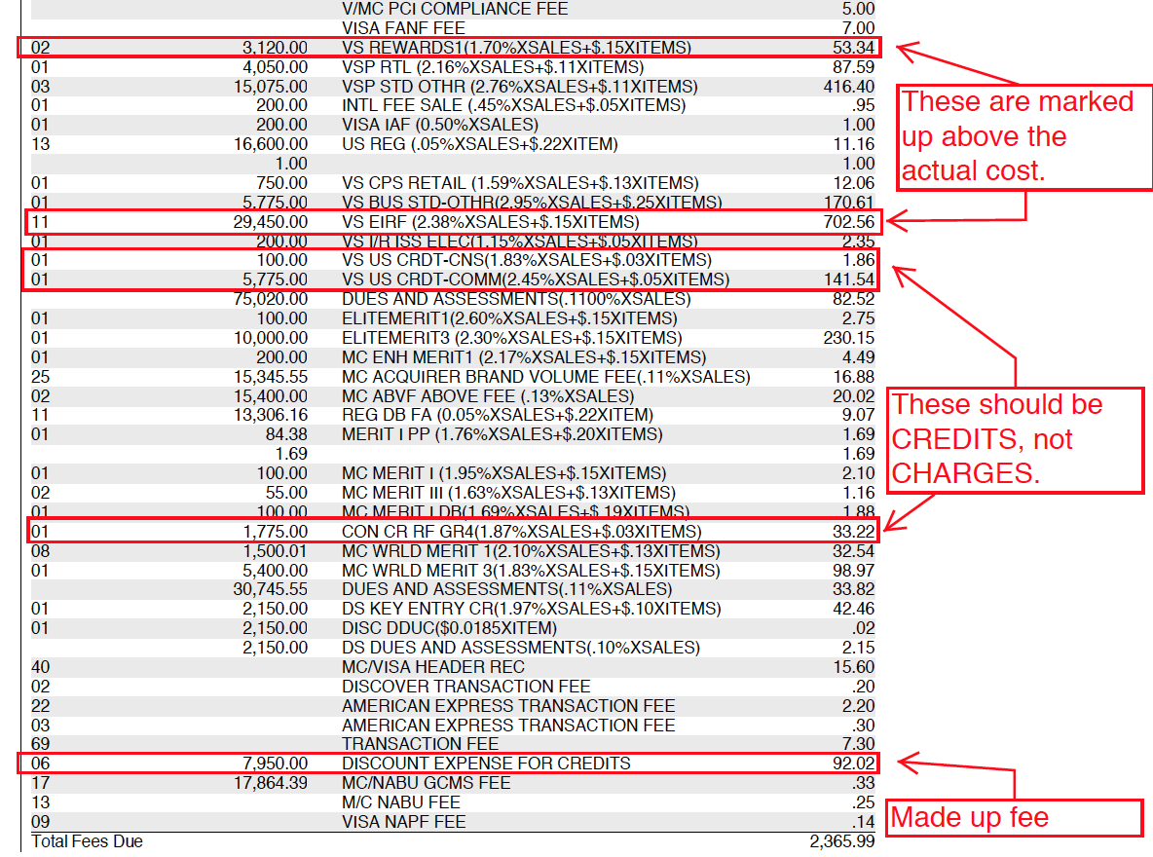
Marked up & made up fees, and incorrect charges/credits
ANALYZE

Slide 7
ADJUST
How it works: Each month the practice will receive a Merchant Advocate Savings Report:
Dear *********,
This is an explanation of your savings for the month of July 2020
Total Volume $54,588.43
Your Old Net Rate Was 3.88%
What You Would Have Paid at Your Old Net Rate $2,118.03
What You Actually Paid After Our Adjustments $1,095.49
Your New Net Effective Rate Is 2.01%
Your Gross Savings $1,022.54
Our Consulting Fee $511.27
Your Net Savings $511.27

Slide 8
ADJUST
How it works: Each month the practice will receive a Merchant Advocate Savings Report:
Example of a merchant on track to net more than $7,300/year
Dear *********,
This is an explanation of your savings for the month of July 2020
Total Volume $54,588.43
Your Old Net Rate Was 3.88%
What You Would Have Paid at Your Old Net Rate $2,118.03
What You Actually Paid After Our Adjustments $1,095.49
Your New Net Effective Rate Is 2.01%
Your Gross Savings $1,022.54
Our Consulting Fee $409.02
Your Net Savings $613.52

Slide 9
Case Study
Why we audit
Why We Audit
Oral surgeon – average gross annual savings – $8,714
Rate Increase #1 at 18 months – eliminated
Rate Increase #2 – 6 months later – eliminated
Our efforts prevented his processor from charging him more than $6,300 in additional annual fees

Slide 10
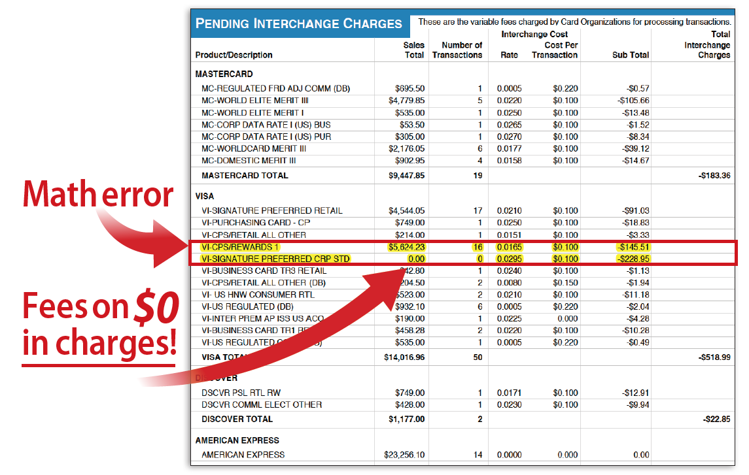
Are You doing the Math?

Slide 11
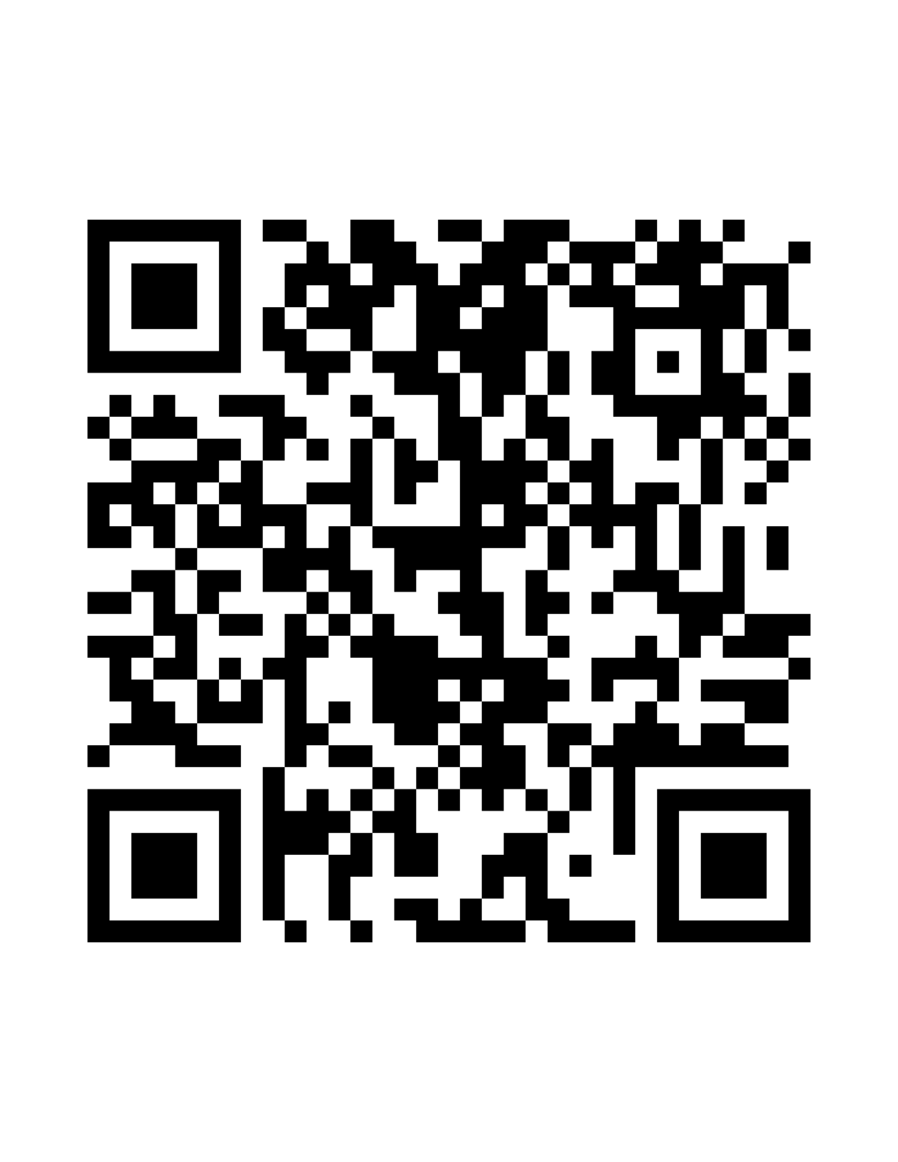
INDEPENDENT ADVOCATES DELIVERING RISK-FREE, PROVEN RESULTS
Howard Goldstein
206-387-0189
hgoldstein@merchantadvocate.com
SAVE MONEY
GET RESULTS

